Slide 1




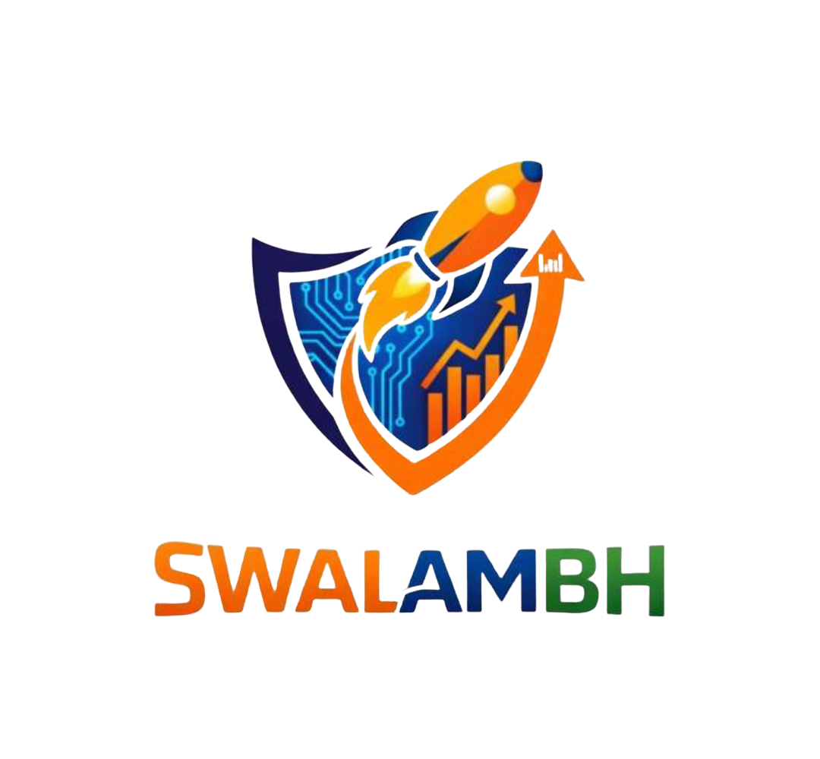
Hacktivate syndicate
IEDC
  Project / Idea Name: EduPath AI
  Team Name: Hacktivate syndicate
  Team Members: Trupal Shende , Yadni zade , Anshul Gaikawad , Srusty Dhoble , Dhanashri Yelne
  Domain(Emerging technology): ML & GEN AI
Title Page

Slide 2
Hacktivate
syndicate
Problem Statement
Engineering students planning to study abroad face confusion in university selection, eligibility criteria, and job market ROI… Develop a Human + AI-assisted overseas guidance framework…

Slide 3
Market Need
Hacktivate
syndicate
Growing Demand: Over 7.5 Lakh+ Indian engineering students seek overseas education annually.
Economic Stakes: Average education loan is ₹30L–₹50L; accuracy in selection is non-negotiable.
Service Gap: Current consultancies are manual, slow, and often lack real-time employability data.
Interoperability: Need for a unified system that handles diverse grading systems (CGPA vs. GPA).

Slide 4
Proposed Solution
Hacktivate
syndicate
Human + AI Hybrid: An AI engine that generates shortlists, validated by human experts.
Predictive Analytics: ML models to predict admission probability and financial ROI.
Multimodal RAG: A "Living Knowledge Base" of global university policies and visa norms.
Automated Profiling: Intelligent extraction of "Skill Graphs" from student resumes/transcripts.

Slide 5
Prototype/Demo Overview/Working
Model Screenshots
Hacktivate
syndicate
. Student Dashboard: Profile intake, ROI Heatmaps, and AI Chatbot Advisor.
Counselor Console: Large-scale dataset management with AI-suggested "Top 5 Matches" per student.
ROI Graph: Visual projection of Salary vs. Loan Repayment timeline.
Real-time Feedback: Human counselor "Approve/Reject" buttons for AI recommendations

Slide 6
Technology Stack
Hacktivate
syndicate
LLM Engine: Gemini 2.5 Flash (for Multimodal Reasoning & RAG).
Vector Database: Pinecone (Storing 5000+ university brochures).
Backend: Node.js / Python (FastAPI).
Frontend: React / Tailwind CSS.
Database: Firebase (Auth & Real-time student-counselor sync).

Slide 7
System Architecture
Hacktivate
syndicate
Data Layer: University PDFs + Job Market Stats -> Vector Embeddings.
Processing Layer: Student Input -> Gemini Embedding -> Vector Search -> RAG Output.
Validation Layer: AI Output -> Human Counselor Review -> Final Verified Recommendation.
Output Layer: Interactive Dashboard + ROI Projection.

Slide 8
Innovation & Uniqueness
Hacktivate
syndicate
ROI-First Approach: Focuses on "Time-to-Breakeven" rather than just university rankings.
Skill-Based Matching: Analyzes technical project impact (GitHub/Resumes) instead of just test scores.
RLHF Integration: AI learns from human counselor edits to improve future accuracy.
Contextual RAG: Cites official university sources to eliminate AI hallucinations.

Slide 9
Business Modal
Hacktivate
syndicate
B2B SaaS: Subscription-based model for overseas education consultancies (Per Student Credit).
B2C Premium: Direct-to-student "AI Plus" plan for deep ROI analytics and document review.
B2B2C: Partnerships with education loan providers for pre-approved credit based on ROI score.

Slide 10
Market & Competitors
Hacktivate syndicate
Traditional: IDP, LeapScholar (Heavy human dependency, slower turnaround).
Niche Tools: Yocket, AdmitPredictor (Static data, lack of deep multimodal reasoning).
EduPath AI Edge: 10x faster processing + Verified ROI data + Human-in-the-loop accuracy.

Slide 11
Scalability
Hacktivate syndicate
Horizontal: Expanding from Engineering to Medicine (MedTech) and Management (MBA) domains.
Vertical: Integrating Visa automation and SOP (Statement of Purpose) AI-review modules.
Geographic: Moving from the Indian market to other high-outflow regions like SE Asia and Africa.

Slide 12
Chalanges Faced
Hacktivate syndicate
Data Normalization: Converting non-standardized university grading systems (CGPA to 4.0 scale).
Real-time Accuracy: Keeping up with rapidly changing visa and post-study work policies.
Explainability: Ensuring the AI can explain why a university was selected to gain user trust.

Slide 13
Future Roadmap
Hacktivate syndicate
Phase 1: Launch MVP for Engineering (USA, UK, Germany).
Phase 2: Integrate Alumni-Peer matching via AI.
Phase 3: Direct university API integration for one-click application filing.
Phase 4: AI-assisted Scholarship discovery and auto-application.

Slide 14
Social/Industrial Impact
Hacktivate
syndicate
Financial Literacy: Empowers students to make debt-conscious education choices.
Efficiency: Reduces counselor workload by 80%, allowing focus on high-impact mentorship.
Democratization: Provides Tier-2/Tier-3 city students with "Metro-level" counseling expertise.
Industry Alignment: Better matching of student skills to global market requirements.

Slide 15
Conclusion
Hacktivate
syndicate
EduPath AI is redefining the overseas education funnel.
Vision: To eliminate "Decision Fatigue" and ensure every student gets a high-ROI global education.
Impact: A data-driven, scalable framework that bridges the gap between ambition and employability.

